Slide 1
Angle Relationship Notes
Shapes and Designs
Problem 3.4

Slide 2
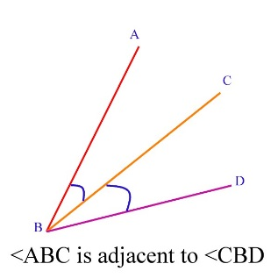
Adjacent Angles Two angles that share a ____________ and a ___________. They may not __________________. Angle ABC is _____________________ to angle CBD. ____________ is the side they share, and ___________ is the common vertex. Adjacent angles tell us _____________ about the measures of the angles.
side
vertex
overlap
adjacent
$$\overline{BC}$$
B
nothing

Slide 3
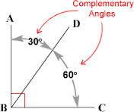
Complementary angles TWO angles that have a sum of _______________. Since the 30° angle and the 60° angle form a _____________ ________________, they are ______________________. If two lines, rays or segments meet and form right angles, they are _________________________. If the measure of angle 1 is 30°, the measure of angle 2 must be ______________ because the two angles must add up to ________°
(remember Co – 90!!!)
90°
Right
angle
complementary
complementary
60°
90°

Slide 4
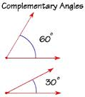
Complementary angles Since one angle measures 30° and the other measures 60°, the sum of their measures is __________° therefore, the two angles are _________________. Complementary angles _______________ need to be __________________.
90°
complementary
DO NOT
adjacent

Slide 5
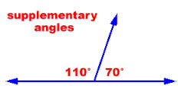
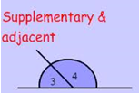
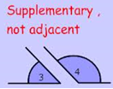
Supplementary angles TWO angles whose measures add up to __________°. Since the 110° angle and the 70° are LINEAR, together they form a straight line, they are _______________________. Since the sum of the two angles is _________°, they are called _________________. Supplementary angles __________ need to be ____________.
180
supplementary
180
supplementary
DO NOT
adjacent

Slide 6
Vertical Angles Angles formed by the ______________ of two ____________ ____________. They are ______________ from ______ __________. Vertical angles are ALWAYS _____________________.
intersection
straight
lines
opposite
each
other
38°
52°
1
2
congruent

Slide 7
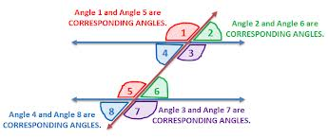
Corresponding Angles A pair of angles that are formed when two _______________ lines are cut by a _____________________. These two angles are in the same ______________ at each intersection. If the ______________ were cut in half and laid on top of each other, the two angles would be in the same _________ or _________. Corresponding angles are ______________ ______________.
parallel
transversal
location
transversal
location
position
always
congruent

Slide 8
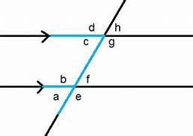
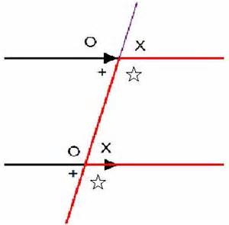
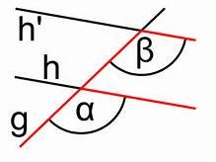
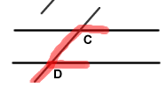
Corresponding angles can be tested using the “F” test…

Slide 9
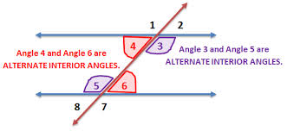
Alternate Interior Angles Two angles that are _____________ parallel lines and are on opposite sides of a _________________. The measures of alternate interior angles are always ______________________.
inside
transversal
congruent

Slide 10
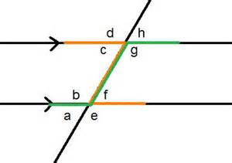
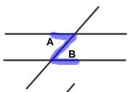
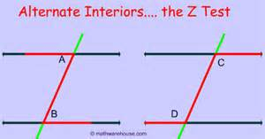
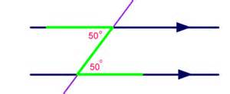
Alternate Interior angles can be tested with the “Z” test…

Slide 11
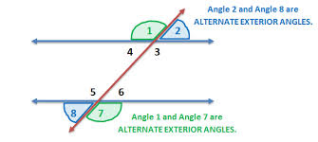
Alternate Exterior Angles Two angles that are _______________ parallel lines and are on opposite sides of a __________________. The measures of alternate exterior angles are always ______________________.
outside
transversal
congruent

Slide 12
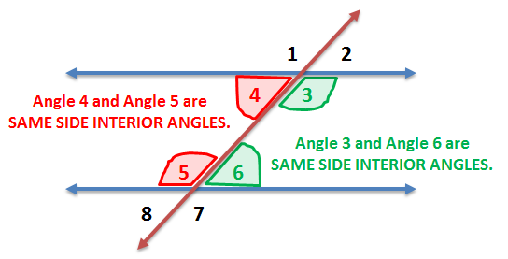
Same Side Interior Angles Two angles that are _______________ parallel lines and are on the ________________ side of the ________________. The measures of same side interior angles always add up to _______ and are ______________________.
inside
same
transversal
180°
supplementary

Slide 13
Same Side Exterior Angles Two angles that are _______________ parallel lines and are on the ________________ side of the ________________. The measures of same side exterior angles always add up to _______ and are ______________________.
outside
same
transversal
180°
supplementary

